Slide 1
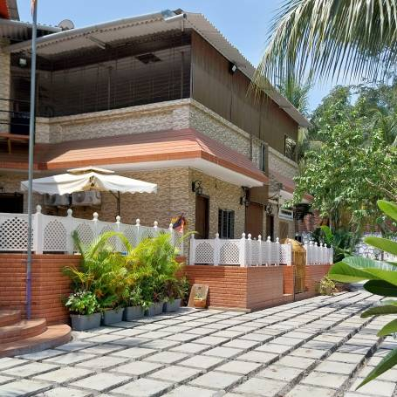
Drug Rehabilitation Centre in Navi Mumbai

Slide 2
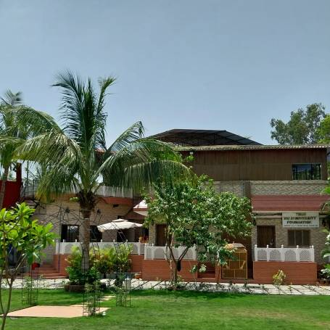
THF Wellness is a psychiatric facility specialising in treating mental health patients. We offer a variety of services, including individual therapy, group therapy, and medication management…
"In the race against time, addiction will always slow you down in the fast city life." - Trucare Trust can help you with our top-rated addiction treatment Program. Call +91-9321763075 for more details. You can also visit our website - https://thfwellness.com
Google map : https://goo.gl/maps/YvrmfzkqVzWiRYhj7

